Slide 1
IT Security MUST
Support to ”The Business”
IT Security people MUST understand ”The Business” and ”The Business need” to be able to manage IT Security

Slide 2
IT Security Management
Final decisions about IT Security must be taken by ”The Business Expert” (”The Management”)
”The Management” only must decide ”The level of IT Security” in the company in relation to:
  Values (assets)
  Image
  Business Risks
  Requirements from Customers, Partnerships and Company
Business management must
  Control the entire cycle of IT Securiy activities
  Maintain and follow-up regularly
  Reports

Slide 3
A three pronged ISMS approach
Sets framework for:
  Management goal setting based on prioritised risk
  Setting up a structured system with essential elements and methods
  Enables internal and external evaluation for further system development (improvement)
ISMS
Notes:
Notes:

Slide 4
Who needs ISMS?
Every organisation, company, firm institution handling information: BASICALLY EVERYBODY!
  Banks
  IT companies
  Government (example: tax office)
  Consultancy Firms
  Hospitals
  Schools and Universities
  Insurance Companies
  Certificate Service Providers, CSPs
  … just to name a few!
Notes:
Notes:

Slide 5

Risk assessment
The bases for ISMS
Inger Nordin
Risk assessment
The basis for ISMS
Per Rhein Hansen

Slide 6
Implementing an Information Security Management System
There are key steps that every company implementing an Information Security Management System will need to consider:
Purchase the Standard
Before you can begin preparing for your application, you will require a copy of the standard. You should read this and make yourself familiar with it.
Consider Training
There are training courses available to help you implement and assess your Information Security Management System.
Assemble a team and agree your strategy
You should begin the entire implementation process by preparing your organizational strategy with top management. At this stage you should determine the Scope of your Registration - whether the system will be adopted company wide or by one or more departments.
Review Consultancy Options
You can receive advice from independent consultants on how best to implement your information security management system.
Undertake a Risk Assessment
During this phase you should undertake a review of all potential security breaches. This should not relate solely to IT systems, but should encompass all sensitive information within your organization.
Develop a Policy Document
This will demonstrate management support and commitment to the Information Security Management System process.
Develop Supporting Literature
Put together a Statement of Applicability and Procedures to support your security policy. This will cover a range of areas including asset clarification and control, personal security, physical and environmental security and business continuity management.
Choose a registrar
The registrar is the 3rd party, like BSI, who come and assess the effectiveness of your information security management system, and issue a certificate if it meets the requirements of the standard. Choosing a registrar can be a complex issue as there are so many operating in the market. Factors to consider include industry experience, geographic coverage, price and service level offered. The key is to find the registrar who can best meet your requirements. A great place to start is by contacting us.
Implement your Information Security Management System
The key to implementation is communication and training. During the implementation phase everyone begins operating to the procedures of the management system.
Gain registration You should arrange your initial assessment with your registrar. At this point the registrar will review your Information Security Management System and determine whether you should be recommended for registration.
Continual assessment
Once you have received registration and been awarded your certificate, you can begin to advertise your success and promote your business. Your ISMS will be periodically checked by your registrar to ensure that it continues to meet the requirements of the standard.
http://emea.bsi-global.com/InformationSecurity/ImplementingISMS/index.xalter

Slide 7
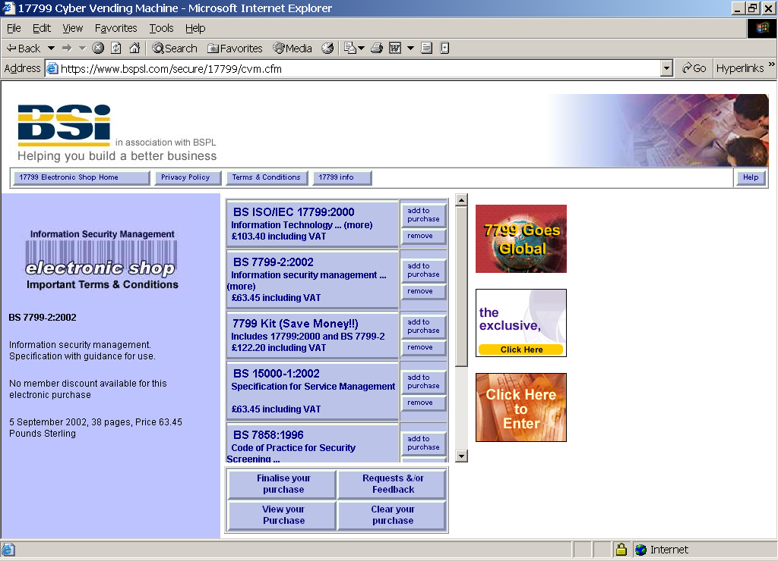

Slide 8
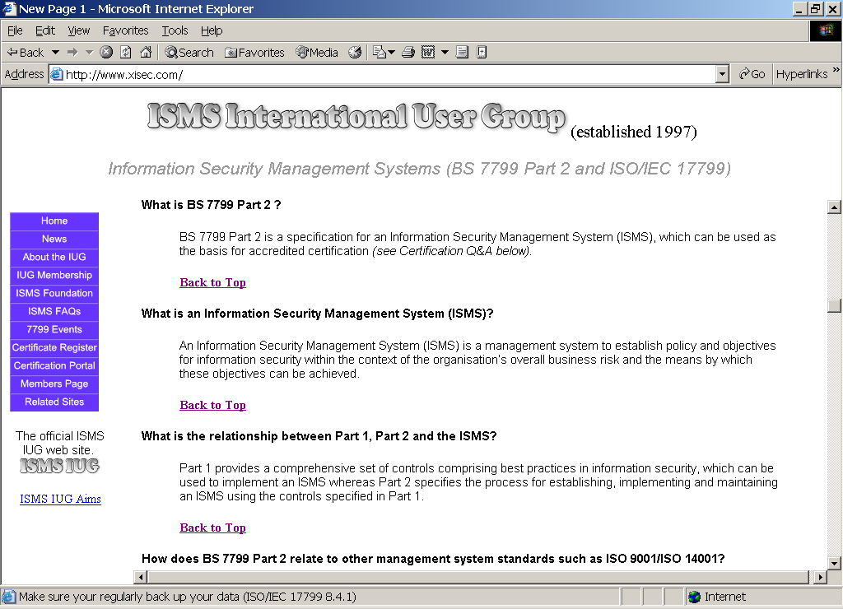

Slide 9
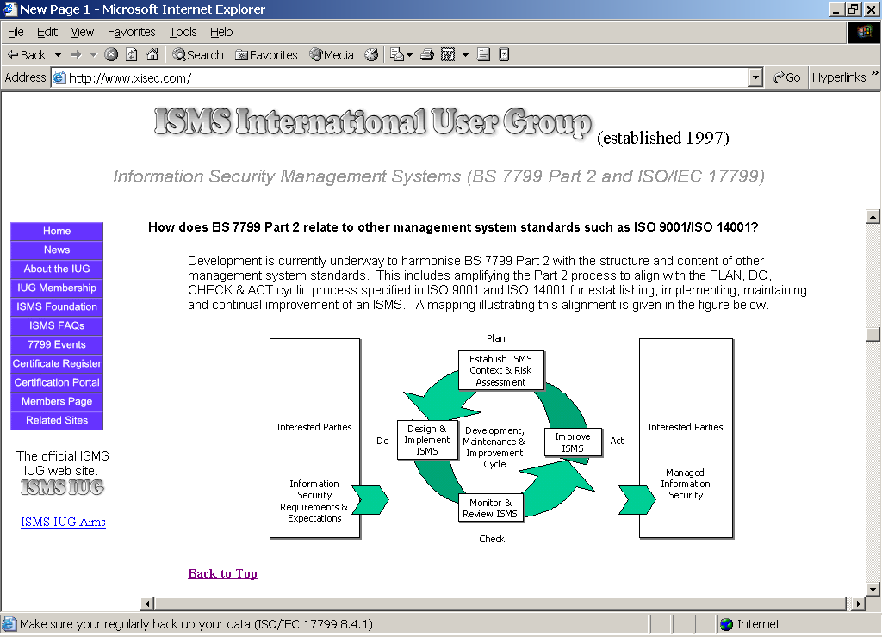

Slide 10
Comparison SHALL and SHOULD standards
BS 7799-2:2002 -- SHALL
1 Scope
Normative references
Terms and definitions
Information security
management system
Management responsibility
Management review of the ISMS
ISMS improvement
Annex A (normative) Control objectives and controls
- table mapping ISO/IEC 17799
Annex B (informative) Guidance on use of the standard
Annex C (informative) Comparison between ISO 9001:2000, ISO 14001:1996 and BS 7799-2:2002
Annex D (informative) Changes to internal numbering
ISO/IEC 17799:2000 -- SHOULD
1 Scope
2 Terms and definitions
3 Security policy
4 Organizational security
5 Asset classification and control
6 Personnel security
7 Physical and environmental security
8 Communications and operations management
9 Access control
10 Systems development and maintenance
11 Business continuity management
12 Compliance

Slide 11
Changes from BS 7799, part 2:1999 to BS 7799-2:2002
Adopted to ISO 9001 and ISO 14001
  Better description of management system
  Focus on Plan, Do, Check and Act - process
  Focus on risk assessment, risk handling, ...
  Corresponding tables
    BS 7799, part 2, ISO 9001:2000 och ISO 14001
    BS 7799, part 2:1999 and BS 7799, part 2:2002
BS 7799-2 and ISO/IEC 17799 should be viewed as an entity
  Requirements in part 2 including description of the ISMS and Annex A with all the ISO/IEC 17799 controls
Notes:
Notes:

Slide 12
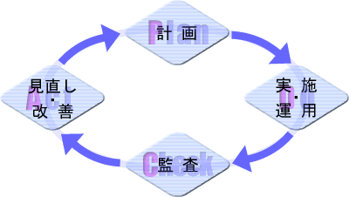
Plan
  Analyse the current situations to identify room for improvement and promising solutions
Do
  Test the solutions in a small scale first in order not to disrupt critical processes
Check
  Find out if the solutions are giving the expected effects, and if they do
Act
  Implement changes on a wider scale

Slide 13
Information Security Management System - ISMS
Interested parties
Information security requirements and expectations
Interested parties
Managed information security
Plan
Establish the ISMS
Implement and operate the ISMS
Development, maintenance and improvement cycle
Do
Maintain and improve the ISMS
Act
Monitor and review the ISMS
Check
Notes:
Noteringar:

Slide 14
ISMS Implementation – according to BS 7799-2:2002 Process Approach
Plan
Establish the ISMS
a) Define scope of the ISMS
b) Define an ISMS policy
c) Define a systematic approach to risk assessment
d) Identify risks
e) Assess the risks
f) Identify and evaluate options for the treatment of risks
g) Select control objectives and controls for the treatment of risks
h) Prepare a Statement of Applicability
Notes:
These activities relates to the implementation of an ISMS and are similar to those necessary to later maintain and develop the system. This approach is also called the ‘Deming circle’.
Plan - Define policy and scope, and identify risks to manage.
A Risk Assessment is crucial. A relative value and importance is set for each asset of the company. The business need of the asset is weight against threats, probability that the threat should occur; that is, the risks, and the consequences.
Do - Identify options for managing the risks, select and implement controls
The Security Organisation is established - responsibilities and authorities are documented and communicated. The Security Forum, with management representative(s) is operative.
With the risk analysis as a base, control objectives and control plans are made and implemented.
A Business continuity plan is prepared and implemented.
Education and training take place to ensure that the organisation understands the signification of the security work and that it can live up to the implemented level of security.
A Statement of Applicability is made addressing selected control objectives and controls.
Check - Monitor and review the ISMS
The policy is reviewed to ensure it remains appropriate.
Managers follow up that security procedures are carried out correctly and are in compliance with policies and standards.
Verification of implemented controls:
-Compliance with legal requirements and the information security policy
-Technical compliance; Incident reporting, software copyright, etc.
Act - Improve the ISMS
Incidents and discrepancies from standards are analysed. Specialists and stakeholders are consulted and necessary preventive actions are implemented. Changes to the system are communicated.
This process must assure that changes in the environment that effects the information security of the business trigs a renewed risk analysis.

Slide 15
ISMS Implementation – according to BS 7799-2:2002 Process Approach
Plan
Establish the ISMS
Do
Implement and operate the ISMS
a) Formulate a risk treatment plan
b) Implement the risk treatment plan
c) Implement controls
d) Implement training and awareness programmes
e) Manage operations
f) Manage resources
g) Implement procedures and other controls for incident handling
Notes:
These activities relates to the implementation of an ISMS and are similar to those necessary to later maintain and develop the system. This approach is also called the ‘Deming circle’.
Plan - Define policy and scope, and identify risks to manage.
A Risk Assessment is crucial. A relative value and importance is set for each asset of the company. The business need of the asset is weight against threats, probability that the threat should occur; that is, the risks, and the consequences.
Do - Identify options for managing the risks, select and implement controls
The Security Organisation is established - responsibilities and authorities are documented and communicated. The Security Forum, with management representative(s) is operative.
With the risk analysis as a base, control objectives and control plans are made and implemented.
A Business continuity plan is prepared and implemented.
Education and training take place to ensure that the organisation understands the signification of the security work and that it can live up to the implemented level of security.
A Statement of Applicability is made addressing selected control objectives and controls.
Check - Monitor and review the ISMS
The policy is reviewed to ensure it remains appropriate.
Managers follow up that security procedures are carried out correctly and are in compliance with policies and standards.
Verification of implemented controls:
-Compliance with legal requirements and the information security policy
-Technical compliance; Incident reporting, software copyright, etc.
Act - Improve the ISMS
Incidents and discrepancies from standards are analysed. Specialists and stakeholders are consulted and necessary preventive actions are implemented. Changes to the system are communicated.
This process must assure that changes in the environment that effects the information security of the business trigs a renewed risk analysis.

Slide 16
ISMS Implementation – according to BS 7799-2:2002 Process Approach
Plan
Establish the ISMS
Do
Implement and operate the ISMS
Check
Monitor and review the ISMS
a) Execute monitoring procedures and other controls
b) Undertake regular reviews of the effectiveness of the ISMS
c) Review the level of residual risk and acceptable risk
d) Conduct internal ISMS audits
e) Undertake management review of the ISMS
f) Record actions and events that could have an impact on the
effectiveness or performance of the ISMS
Notes:
These activities relates to the implementation of an ISMS and are similar to those necessary to later maintain and develop the system. This approach is also called the ‘Deming circle’.
Plan - Define policy and scope, and identify risks to manage.
A Risk Assessment is crucial. A relative value and importance is set for each asset of the company. The business need of the asset is weight against threats, probability that the threat should occur; that is, the risks, and the consequences.
Do - Identify options for managing the risks, select and implement controls
The Security Organisation is established - responsibilities and authorities are documented and communicated. The Security Forum, with management representative(s) is operative.
With the risk analysis as a base, control objectives and control plans are made and implemented.
A Business continuity plan is prepared and implemented.
Education and training take place to ensure that the organisation understands the signification of the security work and that it can live up to the implemented level of security.
A Statement of Applicability is made addressing selected control objectives and controls.
Check - Monitor and review the ISMS
The policy is reviewed to ensure it remains appropriate.
Managers follow up that security procedures are carried out correctly and are in compliance with policies and standards.
Verification of implemented controls:
-Compliance with legal requirements and the information security policy
-Technical compliance; Incident reporting, software copyright, etc.
Act - Improve the ISMS
Incidents and discrepancies from standards are analysed. Specialists and stakeholders are consulted and necessary preventive actions are implemented. Changes to the system are communicated.
This process must assure that changes in the environment that effects the information security of the business trigs a renewed risk analysis.

Slide 17
ISMS Implementation – according to BS 7799-2:2002 Process Approach
Plan
Establish the ISMS
Act
Do
Implement and operate the ISMS
Maintain and improve the ISMS
a) Implement the identified improvements
b) Take appropriate corrective and preventive actions
c) Communicate the results and actions and agree with all interested parties
d) Ensure that the improvements achieve their intended objectives
Check
Monitor and review the ISMS
Notes:
These activities relates to the implementation of an ISMS and are similar to those necessary to later maintain and develop the system. This approach is also called the ‘Deming circle’.
Plan - Define policy and scope, and identify risks to manage.
A Risk Assessment is crucial. A relative value and importance is set for each asset of the company. The business need of the asset is weight against threats, probability that the threat should occur; that is, the risks, and the consequences.
Do - Identify options for managing the risks, select and implement controls
The Security Organisation is established - responsibilities and authorities are documented and communicated. The Security Forum, with management representative(s) is operative.
With the risk analysis as a base, control objectives and control plans are made and implemented.
A Business continuity plan is prepared and implemented.
Education and training take place to ensure that the organisation understands the signification of the security work and that it can live up to the implemented level of security.
A Statement of Applicability is made addressing selected control objectives and controls.
Check - Monitor and review the ISMS
The policy is reviewed to ensure it remains appropriate.
Managers follow up that security procedures are carried out correctly and are in compliance with policies and standards.
Verification of implemented controls:
-Compliance with legal requirements and the information security policy
-Technical compliance; Incident reporting, software copyright, etc.
Act - Improve the ISMS
Incidents and discrepancies from standards are analysed. Specialists and stakeholders are consulted and necessary preventive actions are implemented. Changes to the system are communicated.
This process must assure that changes in the environment that effects the information security of the business trigs a renewed risk analysis.

Slide 18
ISMS Implementation – according to BS 7799-2:2002 Process Approach
Plan
Establish the ISMS
Do
Act
Development, maintenance and improvement cycle
Implement and operate the ISMS
Maintain and improve the ISMS
Check
Monitor and review the ISMS
Notes:
These activities relates to the implementation of an ISMS and are similar to those necessary to later maintain and develop the system. This approach is also called the ‘Deming circle’.
Plan - Define policy and scope, and identify risks to manage.
A Risk Assessment is crucial. A relative value and importance is set for each asset of the company. The business need of the asset is weight against threats, probability that the threat should occur; that is, the risks, and the consequences.
Do - Identify options for managing the risks, select and implement controls
The Security Organisation is established - responsibilities and authorities are documented and communicated. The Security Forum, with management representative(s) is operative.
With the risk analysis as a base, control objectives and control plans are made and implemented.
A Business continuity plan is prepared and implemented.
Education and training take place to ensure that the organisation understands the signification of the security work and that it can live up to the implemented level of security.
A Statement of Applicability is made addressing selected control objectives and controls.
Check - Monitor and review the ISMS
The policy is reviewed to ensure it remains appropriate.
Managers follow up that security procedures are carried out correctly and are in compliance with policies and standards.
Verification of implemented controls:
-Compliance with legal requirements and the information security policy
-Technical compliance; Incident reporting, software copyright, etc.
Act - Improve the ISMS
Incidents and discrepancies from standards are analysed. Specialists and stakeholders are consulted and necessary preventive actions are implemented. Changes to the system are communicated.
This process must assure that changes in the environment that effects the information security of the business trigs a renewed risk analysis.

Slide 19
Process Approach
Business Goals
Follow up phase
Analyzing phase
Development Phase
Awareness
WHY
Plan
WHAT
Design and implement
HOW
Check
Calibrate the ISMS
Improvement cycle
Validation SecurusTM security concept based on ISO/IEC 17799 and BS 7799, part 2
Notes:
Viktigt är att INNAN man börjar med ett införande av LIS ska ledningen ha gett sitt stöd till detta.
Analysfasen ska som ingångsvärde ha Affärsmålen i verksamheten. Detta innebär bl a att riskanalyser fokuserar verksamhetens mål.

Slide 20
ISMS Process Model
The new PDCA (Plan, Do, Check, Act) Process Model in BS7799-2:2002 and the forthcoming Swedish version SS627799-2:2002 adds a new dimension to the 7799-series of international and national standards for information security management systems (ISMS). Now, we can get some guidance on the process of trying to build an ISMS that is compliant with the requirements of the standard. Ever since I heard that the PDCA-cycle was going to be the blueprint process model, I have been trying to understand how this will work in practice. Up until now, I can't see that the PDCA-cycle is really to best route to build an ISMS. However, when it comes to continuous improvement of an already operating ISMS - it is really good.
Some preliminary explanations and further discussions of this matter is found in my thesis (pp. 17-) that can be downloaded in full from the home page of this web site.
In the newly revised version of BS7799-2, the PDCA-cycle is actually used to illustrate at least three different things at the same time. In doing this, it is my opinion that, it tries to be too all-encompassing. Let us have a look of what it tries to illustrate:
1) The creation and implementation of an ISMS
2) The creation of (meta)documentation for third party reviews/certification
3) Continuous imprivement of an existing ISMS
Clearly, these three things differ very much in terms of what activities to execute. Nevertheless all three issues are said to be covered by the Plan, Do, Check, and Act phases.
I argue that the activities involved in creating and implementing an ISMS, including the documentation for the third party reviews, could be better desribed with other labels than PDCA. Let us therefore save the PDCA model to denote activities that has to do with improvment of existing ISMSs. That is exacly analogous to how the PDCA-cycle is used in the area of Quality Management. You don't use PDCA to build the Quality Management System - PDCA is more often largely the result of the QMS.
Here's a short description of the stages in the suggested model. This model does not take into account, at this stage, the meta documentation needed for the certification auditors. If you like to add this to the model, please do and tell me how you did it! This model showed in the picture below takes care of both 1) and 3) in the list above.
Foundation: ISMS context, scope. Top management support, High Level Information Security Policy.
Evaluation: Risk analysis, risk treatment plan, (initial) gap analysis, technical IT security analysis.
Formation: Design / choice of countermeasures (administrative, technical), Writing security documents to different groups in the organsation, developing training programmes, etc.
Implementation: Implement risk treatment plan, conduct training, install technical controls, etc.
Operation: The ISMS is in operation and it generates logs as a result.
Certification: After some months of operation, an independent third party can certify/verify that the ISMS is compliant with the standard.
Operation: The improvement cycle using the PDCA-cycle is continuously working to futher optimise the ISMS so that maximum profits are assured and so that the information security level is at its most optimal level.
If you compare this with the description of the PDCA activities as written in the standard BS7799-2:2002, it should be clear what I am getting at.
If you liked this process model, or if you would like to cooperate with us on ISMS research, please contact bjorck@dsv.su.se. Also, I am very interested to hear from you if you read this page and disagree with me. Please give me your views.
http://www.bjorck.com/isms-process.htm

Slide 21
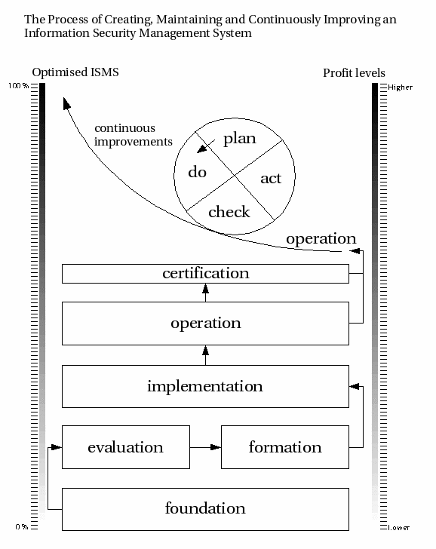
http://www.bjorck.com/isms-process.htm

Slide 22
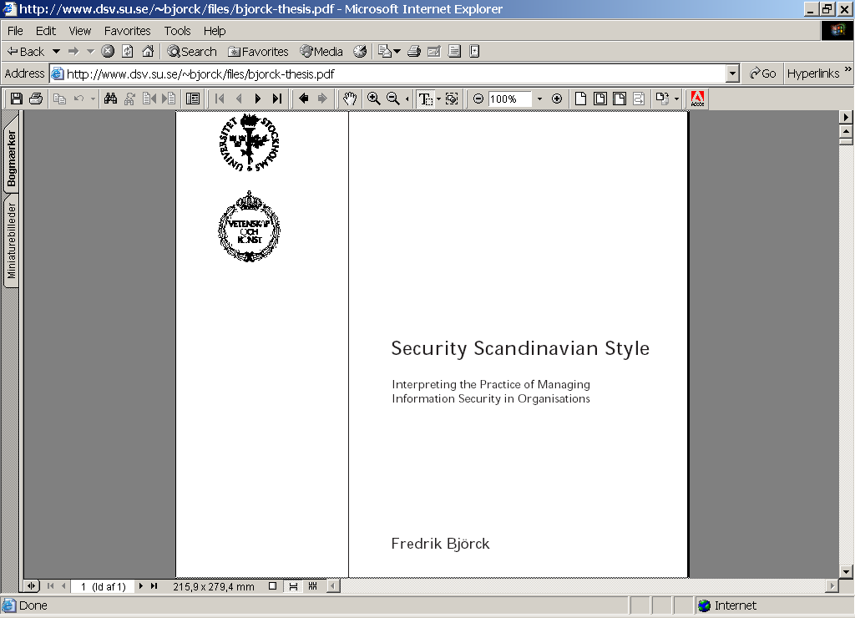
http://www.dsv.su.se/~bjorck/files/bjorck-thesis.pdf

Slide 23
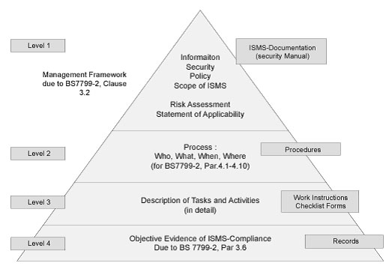
http://www.ids.co.kr/English/service/iso17799.html

Slide 24
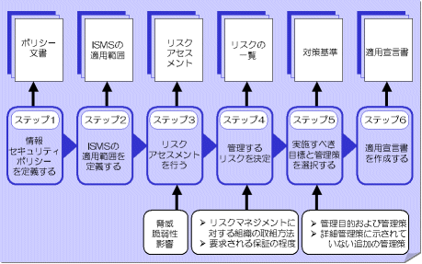
http://www.insi.co.jp/isms/

Slide 25
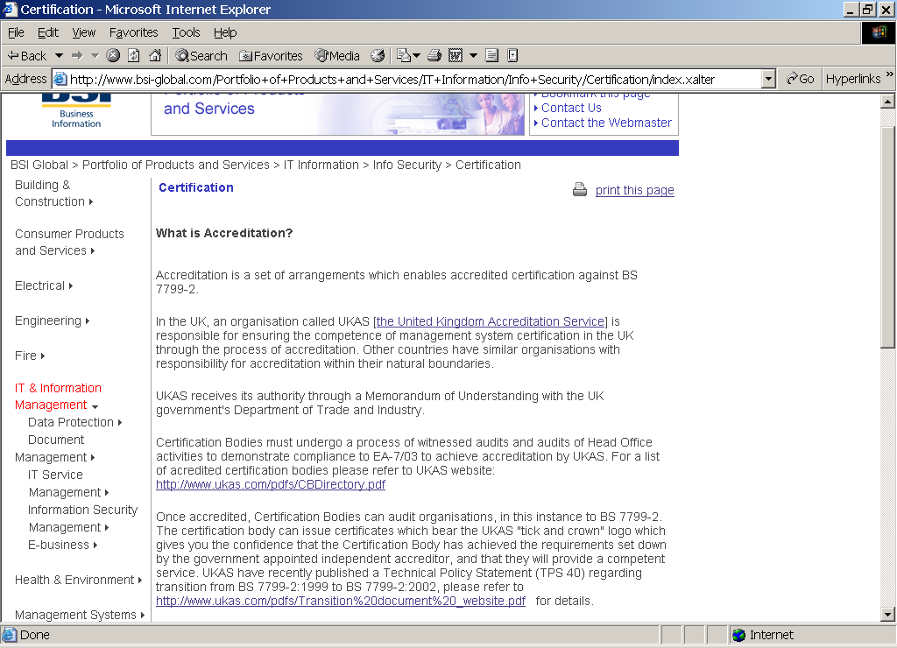

Slide 26
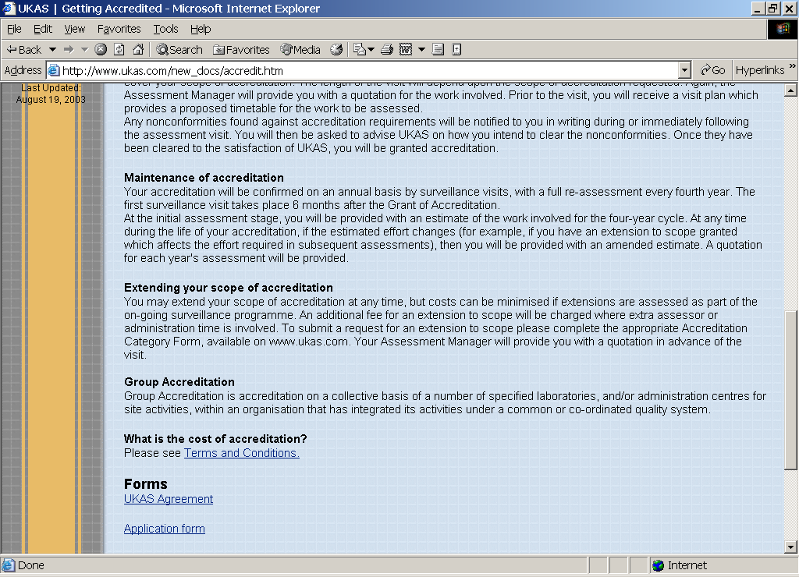

Slide 27
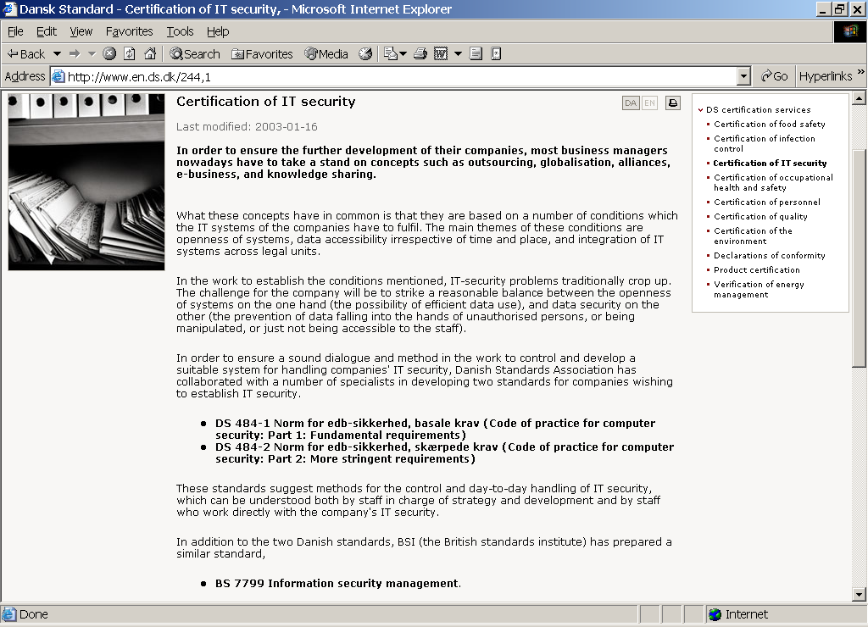

Slide 28
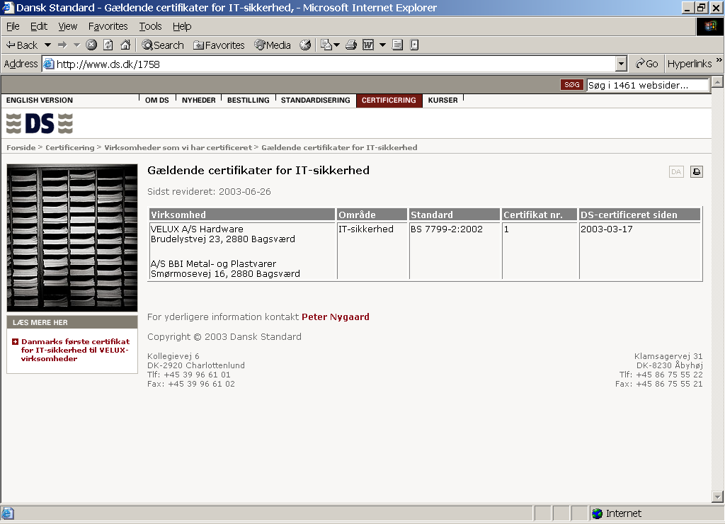

Slide 29
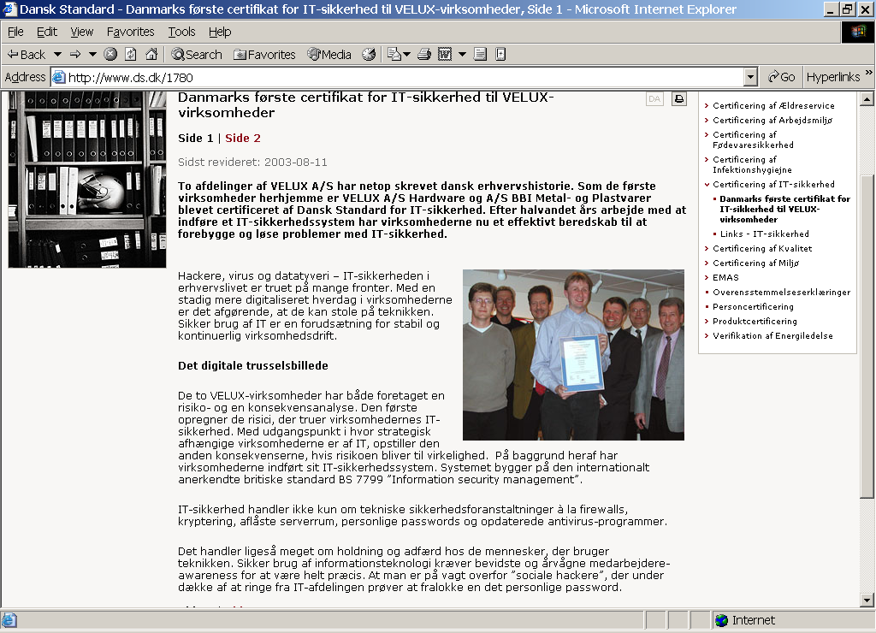

Slide 30
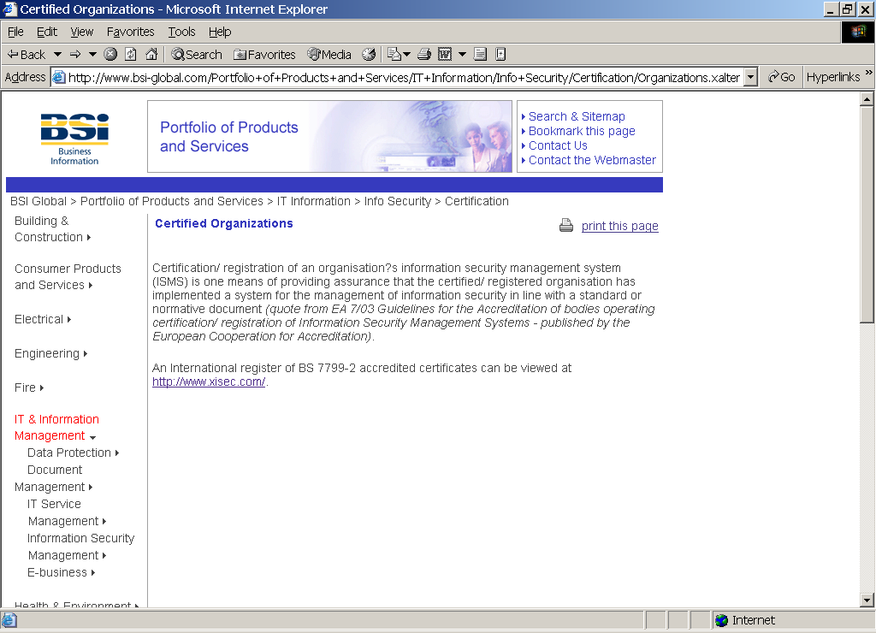

Slide 31
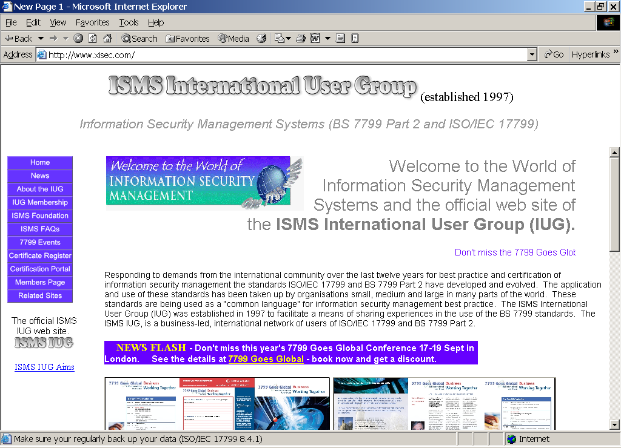

Slide 32
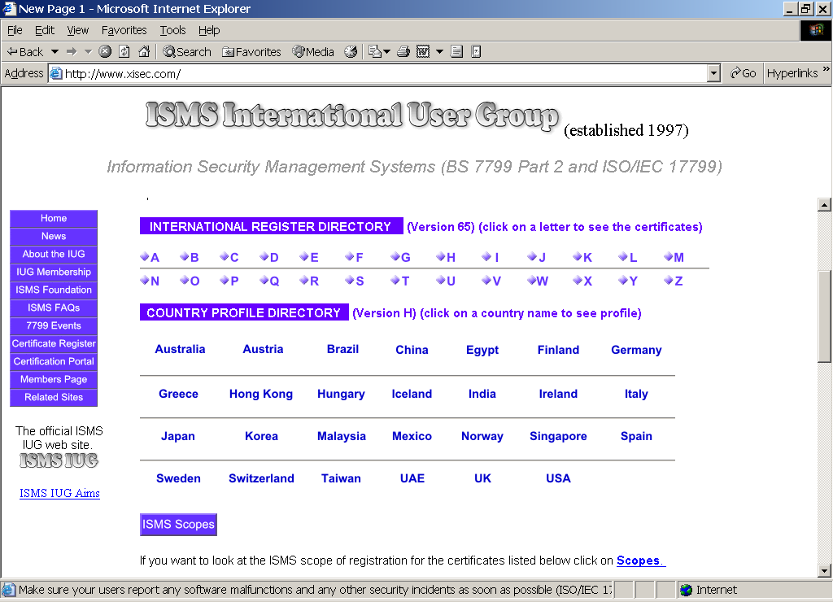

Slide 33
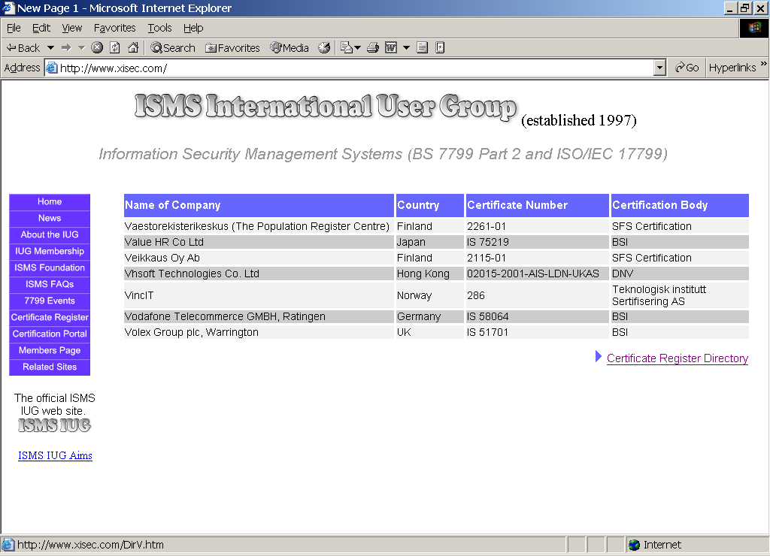

Slide 34
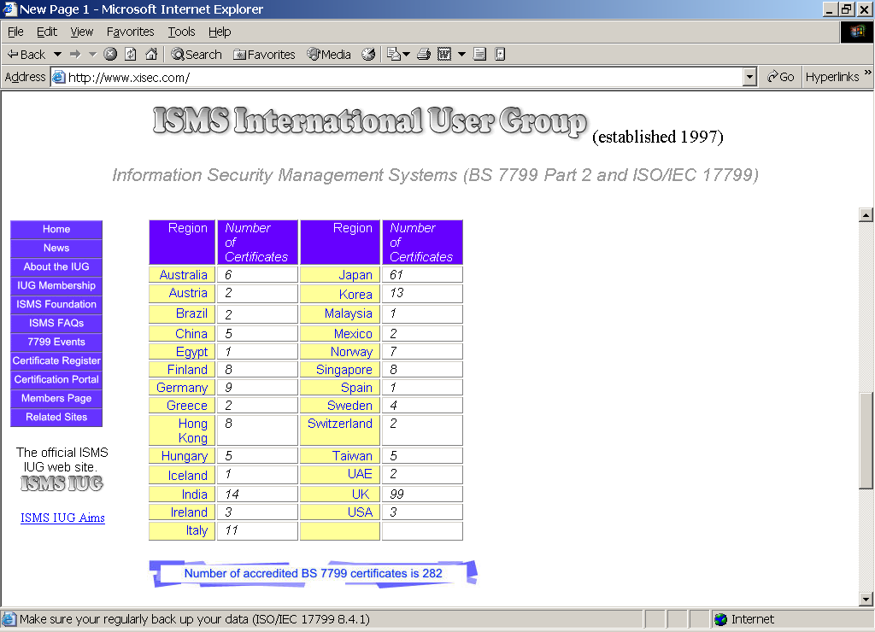

Slide 35
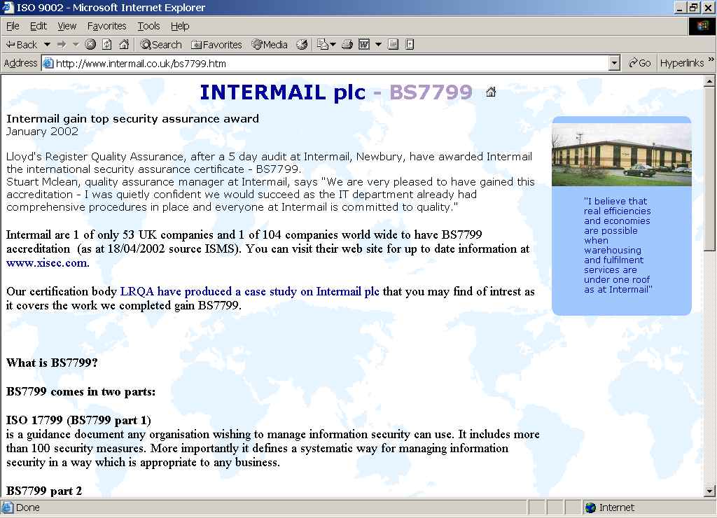

Slide 36
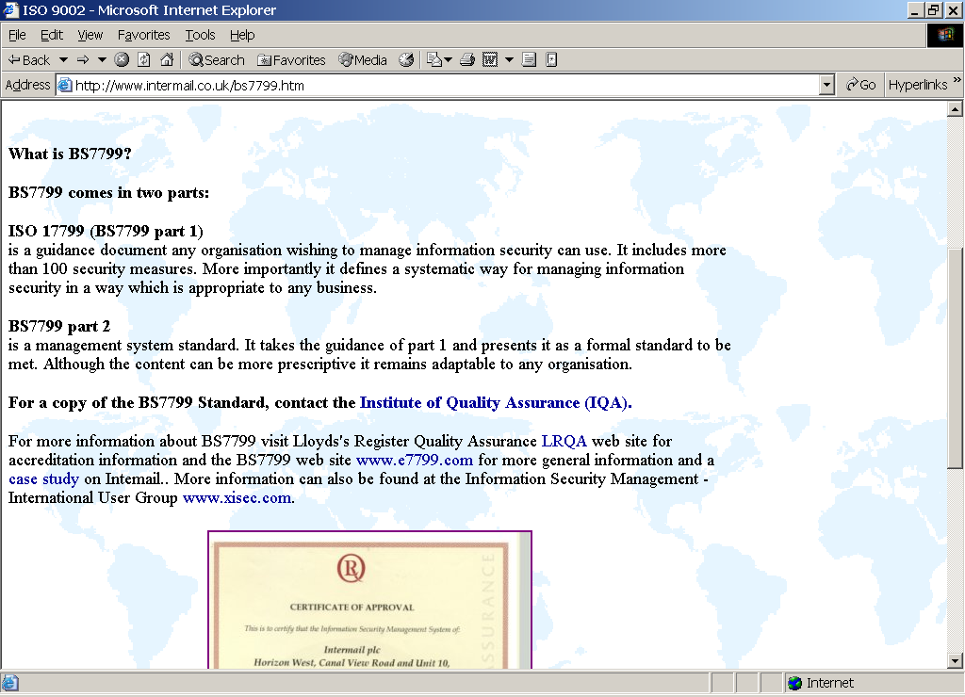

Slide 37
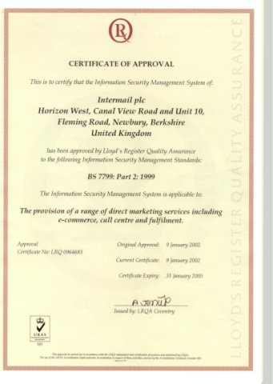

Slide 38
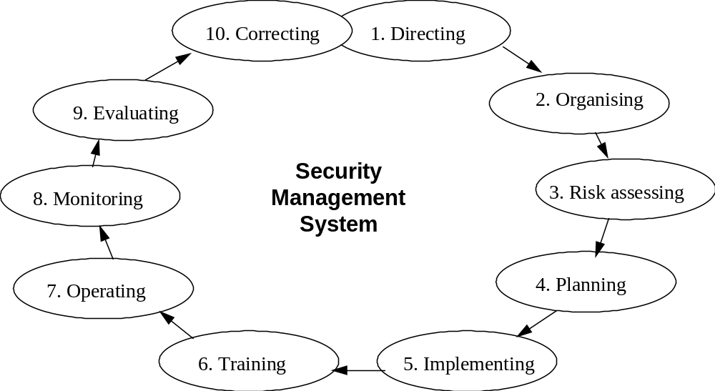
Act
Plan
Check
Do

Slide 39
IT Security Committee
Group of:
  Business Managers
  IT Managers
  IT Security Officer
who estimate:
  New requirement for IT Security
  Need for new Risk Assessment
  Edit IT Security Policy and –Guidelines
  Co-ordinate IT Security tasks
IT Security Committee refer to
  Concern IT Security Manager (IT Security Officer) or
  IT Security Manager

Slide 40
IT Security Organisation
Corporate level
  IT Security Officier (Concern IT Security Manager)
    Normally responsible for one or more IT Security Managers
Company
  IT Security Manager
    Normally refer to board of directors in the Compagny
    Responsible for IT Security Department
  IT Security Consultant
    Staff in the IT Security Department
  IT Security Co-ordinator
    Replacement for IT Security Manager
Department
  Line managers in general are responsible for security within their areas
  IT Security Responsible
    Example a staff in the Network Department responsible for the firewall system
Employees
  To be trained for IT Security Awareness

Slide 41
IT Security Management
IT Security Management shall be handled like ”Quality Management”
”IT Security Management System” like
  ”Quality Management System” (ISO 9000)
  ”Environmental Management Systems” (ISO 14001)

Slide 42
Upgrade
now

Slide 43

Lines of command and response time for activation of a new security shield

Slide 44
IT Security Awareness
Employee training program to obtain
  Commitment for IT Security throughout the organisation
  Increasing awareness and understanding concerning IT Security

Slide 45
IT Security in the real World
Non existing
The issue has become a political one
To low level of IT Security
Old and outdated IT Security Guidelines
The IT Security Management is misplaced in the organization
Missing IT Security policy, vision and strategy
Some of the IT Security people is
  Only for decoration as an aliby for having done something
  Like candy on the fancy cake
  Without any influence

Slide 46


Benefits of ISMS Implementation
Improved understanding of business aspects
Reductions in security breaches and/or claims
Reductions in adverse publicity
Improved insurance liability rating
Identify critical assets via the Business Risk Assessment
Ensure that ”knowledge capital” will be ”stored” in a business management system
Be a confidence factor internally as well as externally
Systematic approach
Provide a structure for continuous improvement
Enhance the knowledge and importance of security-related issues at the management level
Notes:
Notes:

Slide 47
Topic
Content
Information Security Management Systems (ISMS as described in BS 7799-2:2002)
Basics of an ISMS (PRH article or BS 7799-2:2002).
How to guide and control the establishing and
maintenance of IT-security in an organization
Management Guidance (Policies, guidelines)
Why the need for policies and guidance?
Why do we talk about IT-security awareness?
Content of an IT-security policy?
Which kind of guidelines are necessary?
Examples to be shown
Allocation of responsibilities (organization, job-descriptions)
Who should be made responsible for IT-security?
IT-security manager or IT-security coordinator?
Job descriptions shown and discussed as examples
Implementation planning (setting priorities based on risk assessment and available funding)
When a risk assessment is produced, how should the
priorities be decided?
Balancing against costs
Reviewing IT-security versus Auditing IT-security (how to do)
How do you evaluate the IT-security level?
Are guidelines followed?
Compare to standards
Interview
Test what people say
Document
Management follow-up (what top management has to decide on)
How to report to management?
Incident reporting
Deviation reports (deviations from planned
countermeasures)
Management decision on increased budgets or
change of policy / guidelines

Slide 48
Alert !

Slide 49
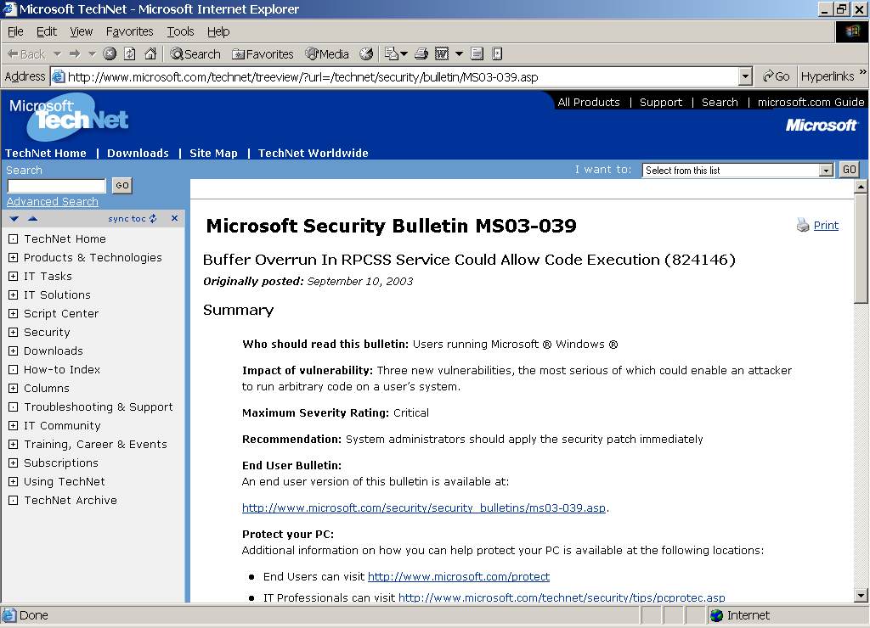

Slide 50


Slide 51


Panic ³
Alert ²
this is an order! ⁴
Factory
likelihood
Threat ¹
carry out ⁵

Slide 52
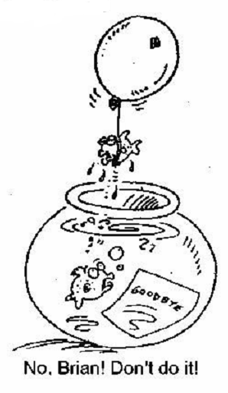

Slide 53
